Slide 1
UNIVERSAL
HEPATITIS C TREATMENT BREAKTHROUGH
Here is where your presentation begins

Slide 2
CONTENTS OF THIS TEMPLATE
Here’s what you’ll find in this Slidesgo template:
A slide structure based on a Breakthrough presentation, which you can easily adapt to your needs. For more info on how to edit the template, please visit Slidesgo School or read our FAQs.
An assortment of graphic resources that are suitable for use in the presentation can be found in the alternative resources slide.
A thanks slide, which you must keep so that proper credits for our design are given.
A resources slide, where you’ll find links to all the elements used in the template.
Instructions for use.
Final slides with:
The fonts and colors used in the template.
A selection of illustrations. You can also customize and animate them as you wish with the online editor. Visit Storyset to find more.
More infographic resources, whose size and color can be edited.
Sets of customizable icons of the following themes: general, business, avatar, creative process, education, help & support, medical, nature, performing arts, SEO & marketing, and teamwork.
You can delete this slide when you’re done editing the presentation.

Slide 3
TABLE OF CONTENTS
OBJECTIVES
METHODOLOGY
01
02
RESULTS ANALYSIS
CONCLUSIONS
03
04
You can describe the topic of the section here
You can describe the topic of the section here
You can describe the topic of the section here
You can describe the topic of the section here

Slide 4
01
OBJECTIVES
You can enter a subtitle here if you need it

Slide 5
INTRODUCTION
You can give a brief description of the topic you want to talk about here. For example, if you want to talk about Mercury, you can say that it’s the smallest planet in the entire Solar System

Slide 6
BACKGROUND
MERCURY
VENUS
MARS
JUPITER
SUN
NEPTUNE
Mercury is the closest planet to the Sun
Venus is the second planet from the Sun
Despite being red, Mars is actually a very cold place
It’s a gas giant and the biggest planet
The Sun is the star at the center of the Solar System
Neptune is the farthest planet from the Sun

Slide 7
130,000
Big numbers catch your audience’s attention

Slide 8
GOALS
MERCURY
NEPTUNE
VENUS
Mercury is the closest planet to the Sun and the smallest one
Neptune is the farthest planet from the Sun. It's really cold there
Venus has a beautiful name and is the second planet from the Sun

Slide 9
METHODS
MERCURY
MARS
Mercury is the closest planet to the Sun
Despite being red, Mars is actually a cold
VENUS
JUPITER
It’s the second planet from the Sun
Jupiter is a gas giant and the biggest planet
NEPTUNE
PLUTO
Neptune is the farthest planet from the Sun
It’s now considered a dwarf planet

Slide 10
AWESOME WORDS

Slide 11
RESEARCH AND PUBLICATIONS
BY MARS
BY VENUS
“Despite being red, Mars is actually a cold place. It's full of iron oxide dust, which gives the planet its reddish cast”
“Venus has a beautiful name and is the second planet from the Sun. It’s terribly hot, even hotter than Mercury”

Slide 12
RESEARCH RESOURCES
You can list your reference websites or publications here
You can list your reference websites or publications here
You can list your reference websites or publications here
You can list your reference websites or publications here
You can list your reference websites or publications here
You can list your reference websites or publications here
You can list your reference websites or publications here
You can list your reference websites or publications here
You can list your reference websites or publications here

Slide 13
FACTORS TO CONSIDER
NEPTUNE
SATURN
MERCURY
VENUS
Neptune is the farthest planet from the Sun. It's really cold there
It has several rings. It's composed of hydrogen and helium
Mercury is the closest planet to the Sun and the smallest one
Venus has a beautiful name and is the second planet from the Sun

Slide 14
—SOMEONE FAMOUS
“This is a quote, words full of wisdom that someone important said and can make the reader get inspired.”

Slide 15
CLINICAL TRIAL
PHASE 1
PHASE 2
PHASE 3
Lab studies
Human safety
Expanded safety
Efficacy & safety
Mars is a actually a very cold place
Venus is the second planet from the Sun
Mercury is the smallest planet
PRECLINICAL

Slide 16
TRIAL TIMELINE
Despite being red, Mars is actually a cold place. It's full of iron oxide dust
RESEARCH
1
Mercury is the closest planet to the Sun and the smallest one in the Solar System
2
EXPERIMENTAL
Neptune is the farthest planet from the Sun. It's also the fourth-largest object
RESULTS
3
Venus has a beautiful name and is the second planet from the Sun. It’s terribly hot
4
CONCLUSIONS

Slide 17
PHASE 1
Young healthy people
20 - 80 Participants
RESULTS
Despite being red, Mars is actually a cold place. It's full of iron oxide dust
80%
20%
MERCURY
80%
MARS
It’s the closest planet to the Sun
Mars is a very cold place
Success rate

Slide 18
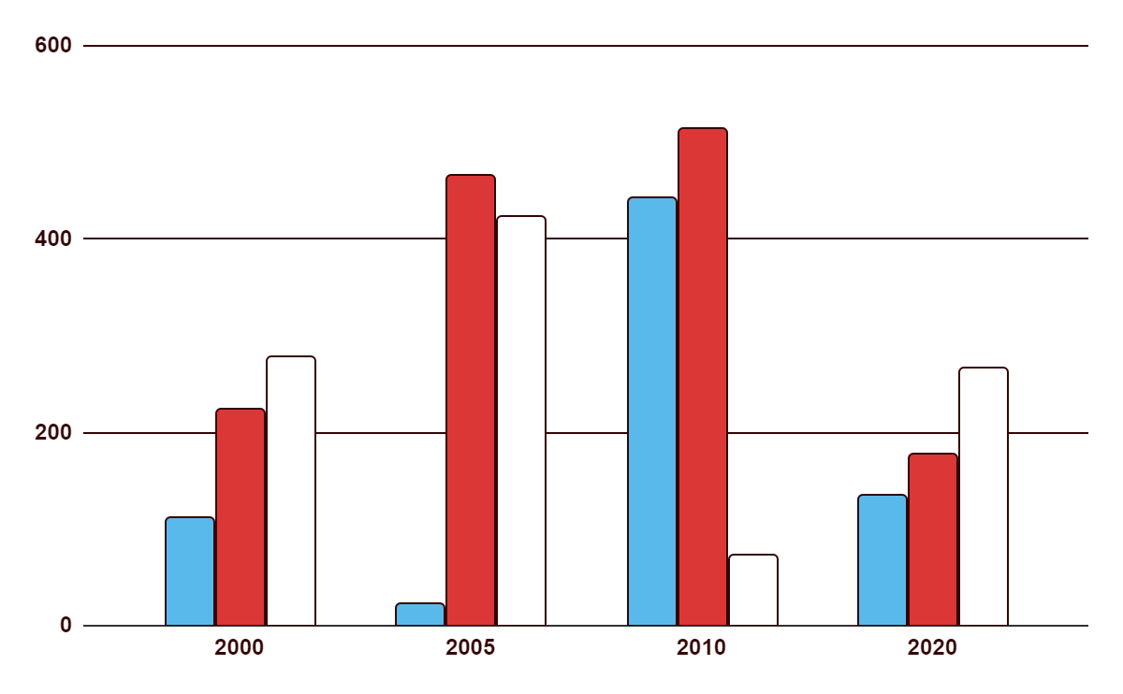
TREND
PHASE 1
Despite being red, Mars is a cold place. It's full of iron oxide dust
PHASE 2
Neptune is the farthest planet from the Sun. It's really cold there
PHASE 3
Saturn is a gas giant. It’s composed of hydrogen and helium
Follow the link in the graph to modify its data and then paste the new one here. For more info, click here

Slide 19
RESULTS
EXPERIMENT A
EXPERIMENT B
 | OUTCOME
TREATMENT | 123 | 42 | 397
GROUP 1 | 256 | - | 423
GROUP 2 | 90 | 89 | 190
GROUP 3 | - | 245 | 99
 | OUTCOME
TREATMENT | - | 36 | 93
GROUP 1 | 315 | 70 | 150
GROUP 2 | 777 | - | -
GROUP 3 | 375 | - | 36

Slide 20
RESULTS ANALYSIS
15%
JUPITER
Venus has a very beautiful name
Jupiter is the biggest planet in the entire Solar System
30%
SATURN
Mercury is the smallest planet
Saturn is a gas giant and is composed of hydrogen and helium
55%
EARTH
Mars is a very cold place
Earth is the third planet from the Sun and the only one with life

Slide 21
SUCCESS RATE
10%
30%
60%
NEPTUNE
MARS
JUPITER
Neptune is the farthest planet from the Sun. It's really cold there
Despite being red, Mars is actually a cold place. It's full of iron oxide dust
Jupiter is the biggest planet in the Solar System. It’s a gas giant

Slide 22
CONCLUSIONS
Do you know what helps you make your point clear?
Lists like this one:
They’re simple
You can organize your ideas clearly
You’ll never forget to buy milk!
And the most important thing: the audience won’t miss the point of your presentation

Slide 23
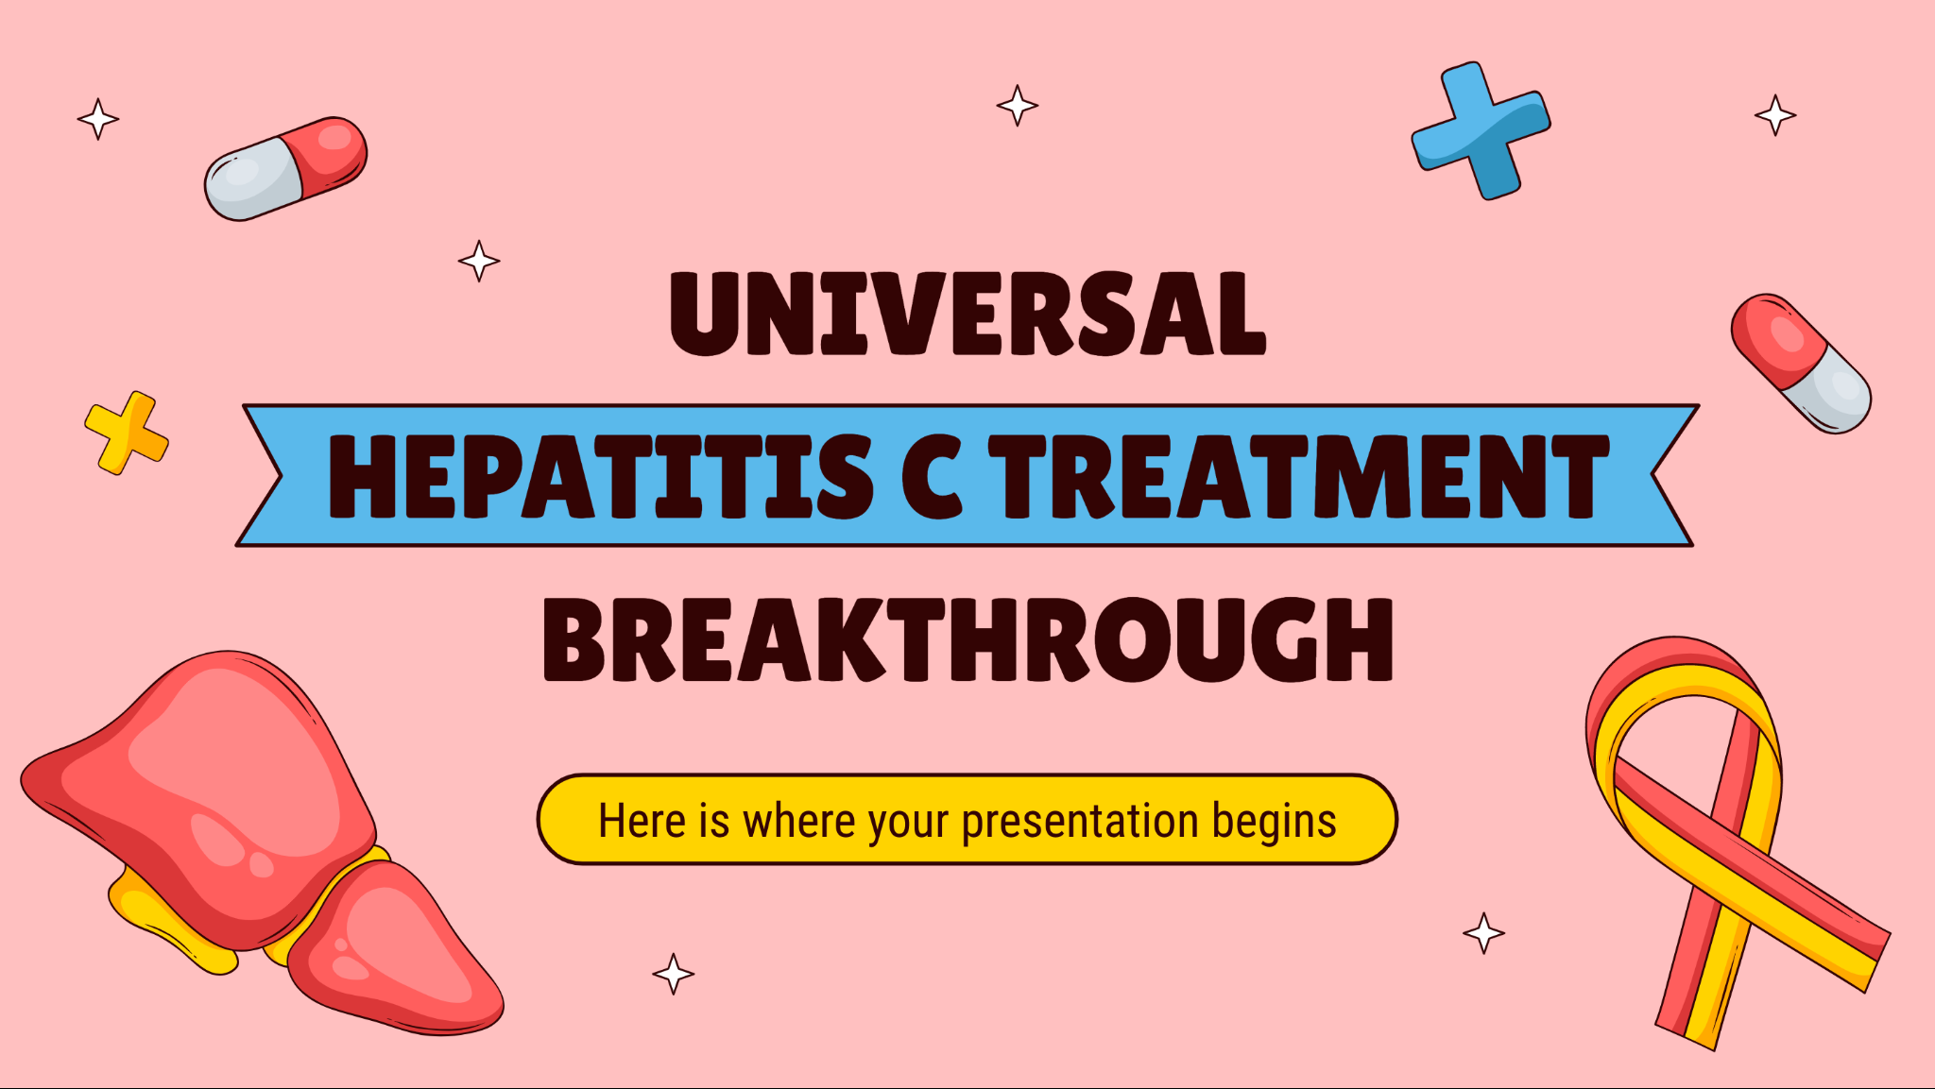
VISIT OUR WEBSITE!
You can replace the image on the screen with your own work. Just right-click on it and select “Replace image”

Slide 24
THANKS!
DO YOU HAVE ANY QUESTIONS?
youremail@freepik.com
+91 620 421 838
yourcompany.com
Please keep this slide for attribution

